Slide 1
Expansion analysis_Retail
File created on: 8/9/2024 12:55:29 AM

Slide 2
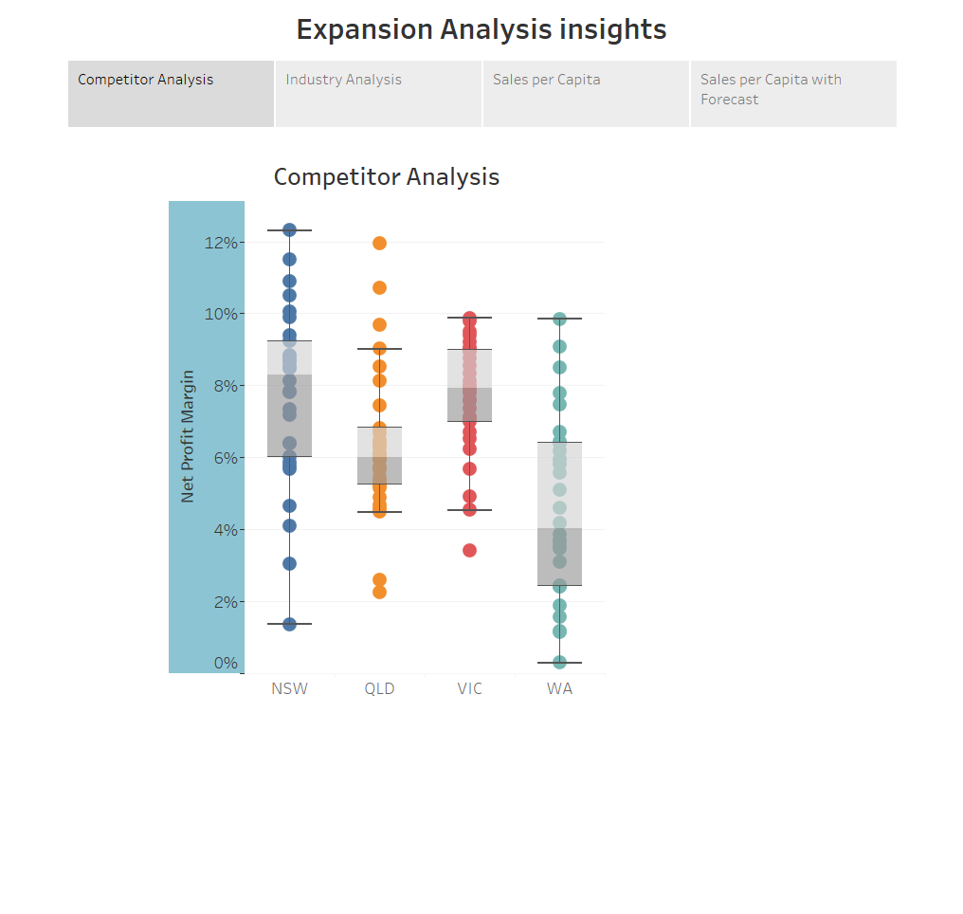

Slide 3
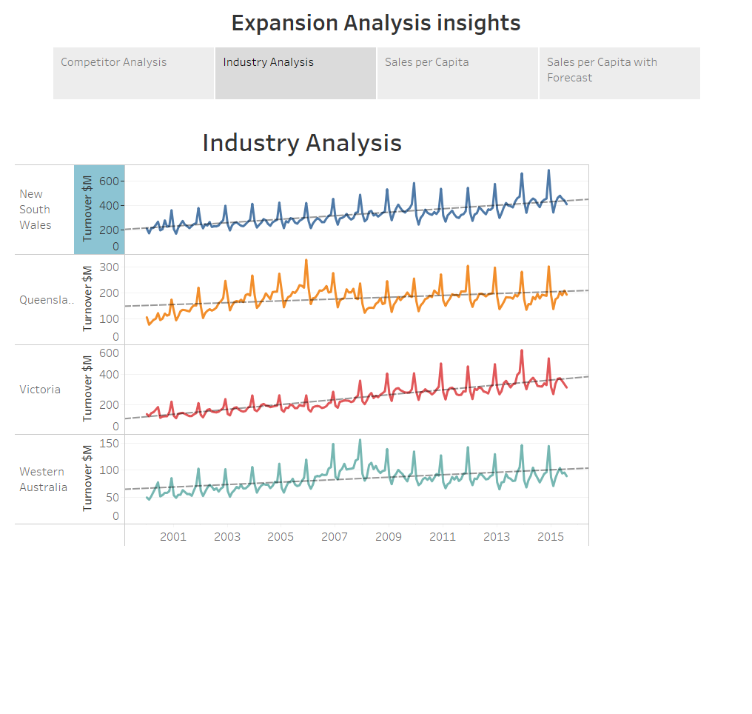

Slide 4
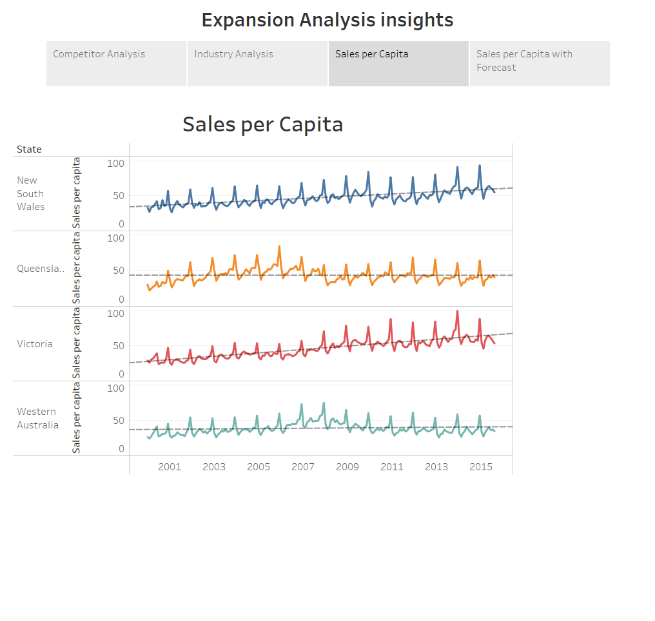

Slide 5
